Slide 1
Capital budgeting: Introduction and techniques
Chapter 9
Professor James Kuhle, Ph.D.

Slide 2
Learning Objectives
LO1: Understand the purpose of capital budgeting
LO2: Know the steps in the capital budgeting process
LO3: Use a variety of techniques to analyze a project
Professor James Kuhle, Ph.D.

Slide 3
LO1: What Does Capital Budgeting Mean?
Capital budgeting concepts
  Investment decisions have a greater impact on a business’s future than any other decisions it makes
Capital budgeting
  The process of deciding which long-term investments or projects a firm will acquire
  A method for evaluating long-term investment opportunities in which all cash flows are discounted to present
Professor James Kuhle, Ph.D.

Slide 4
LO2: Steps in the Capital Budgeting Process
Identification of opportunities
  Firms need some method of identifying opportunities
  Employees on the front lines must have both incentives and means to communicate ideas to those who implement them
Evaluation of opportunities
  All costs and benefits are tabulated
  These are then subjected to analysis
Selection
  Projects must be ranked and selected accordingly
Professor James Kuhle, Ph.D.
Notes:
One of the Apply It activities in the IRG relates to identifying opportunities. Have students do this exercise.
Emphasize how all cash flows are ESTIMATES and can easily be wrong.

Slide 5
Steps in the Capital Budgeting Process (cont.)
Implementation
  Implementation takes time, money, manpower
  Therefore a project’s risk must be properly evaluated
  Costs must be monitored closely
Post audit
  Management compares costs and revenues with the original projections
  Employees are held responsible for errors in projections
Professor James Kuhle, Ph.D.

Slide 6
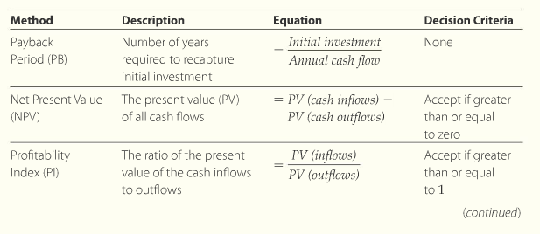
LO3: Techniques for Analyzing Projects
Professor James Kuhle, Ph.D.
Notes:
From p. 9.3.1

Slide 7
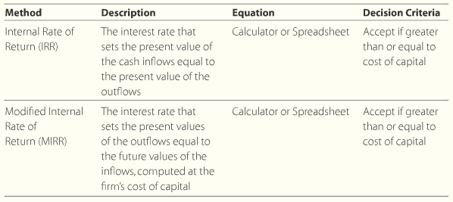
Techniques for Analyzing Projects
Professor James Kuhle, Ph.D.
Notes:
From p. 9.3.2

Slide 8

Payback Period (PB)
Payback period
  The number of years it takes to recover an initial investment
  Mechanically the easiest to compute
  Theoretically the worst evaluation method
Computation
  Payback period is initial investments divided by annual annuity cash flow
Professor James Kuhle, Ph.D.
Notes:
Eq. 9.1 on p. 9.3.3

Slide 9
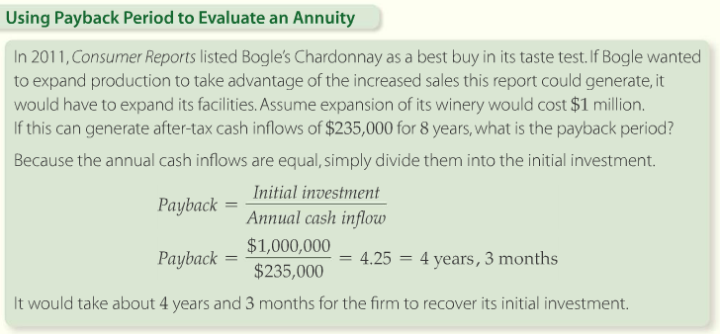
Payback Period (PB)
Notes:
Example from p. 9.3.3

Slide 10
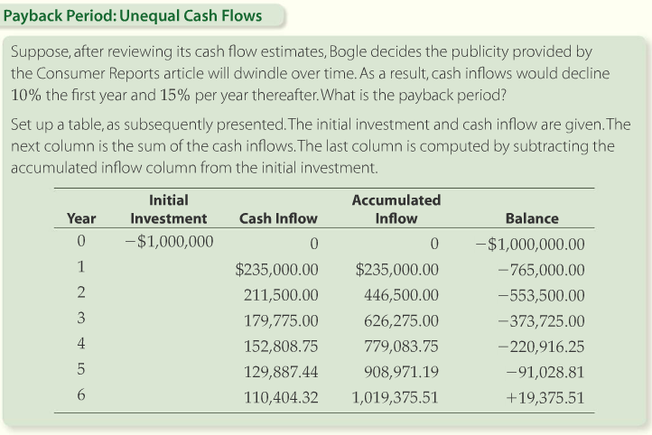
Payback Period (PB)
Professor James Kuhle, Ph.D.
Notes:
Example 9.2 and Solution Tools on p. 9.3.4

Slide 11
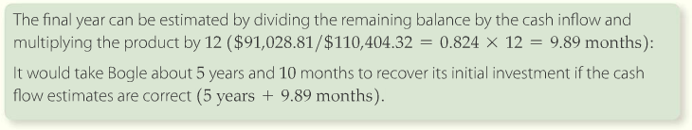
Payback Period (PB)
Professor James Kuhle, Ph.D.

Slide 12
PB Advantages/Disadvantages
Advantages
  Principal advantage of PB is the simplicity
  Provides liquidity information
Disadvantages
  No clearly defined accept/reject criteria
  No risk adjustment
  Ignores cash flows beyond the payback period
  Ignores time value of money
Professor James Kuhle, Ph.D.

Slide 13
Net Present Value (NPV)
Net present value
  The most popular and theoretically sound evaluation tool available to analysts
  The sum or net of all discounted cash flows from a project
Theory
  Cash inflows compared to cash outflows
  If PV of inflows exceed PV of outflows the project is viable
  The difference between PV of cash outflows and PV of inflows is NPV
Professor James Kuhle, Ph.D.

Slide 14


Net Present Value (NPV)
Computation
  To include calculation of present values
Interpretation
  Positive NPV means the current value of income exceeds the current value of expenditure
  Negative NPV means the project costs more than it will bring in
Professor James Kuhle, Ph.D.
Notes:
Equations 9.2 and 9.3 on p. 9.3.9

Slide 15
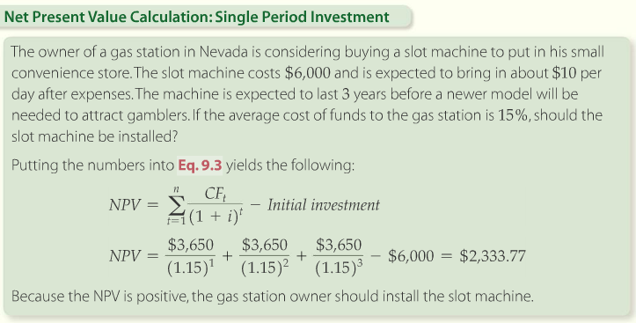
Net Present Value (NPV)
Professor James Kuhle, Ph.D.
Notes:
Solution Tools on p. 9.3.10

Slide 16
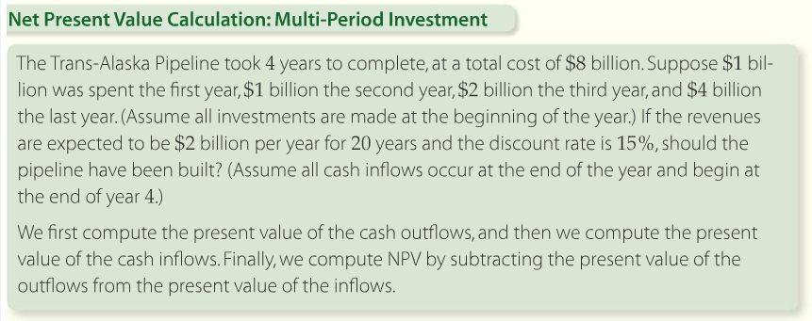
Net Present Value (NPV)
Professor James Kuhle, Ph.D.
Notes:
Solution Tools on p. 9.3.11

Slide 17
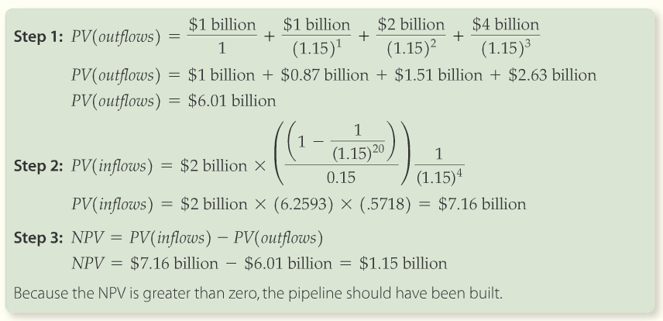
Net Present Value (NPV)
Calculator Solution
PMT = 2
N = 20
I/Y = 15
COMP PV = 12.65
FV = 12.65
N = 4
I/Y = 15
COMP PV = 7.23
- 6.01
1.22
Professor James Kuhle, Ph.D.

Slide 18
NPV Advantages/Disadvantages
Advantages
  Uses time value of money
  Clear decision criterion of NPV > 0 → accept project
  Discount rate adjusts for risk
Disadvantages
  NPV is difficult for someone without a background in financial theory to understand
  NPV is of little help when a company must select among a group of positive-NPV projects
Professor James Kuhle, Ph.D.

Slide 19
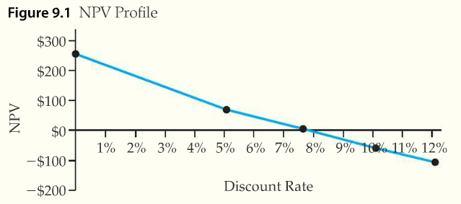
Net Present Value (NPV)
NPV profile
Professor James Kuhle, Ph.D.
Notes:
The NPV profile identifies the range of discount rates where a project would still be viable. It is a form of sensitivity analysis. Graph from p. 9.3.15.

Slide 20
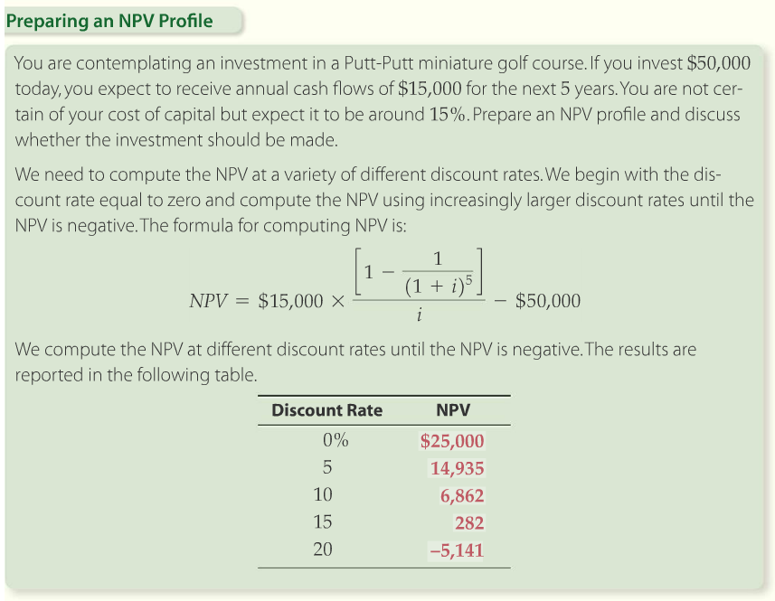
Net Present Value (NPV)
Professor James Kuhle, Ph.D.
Notes:
Solution Tools on p. 9.3.16

Slide 21
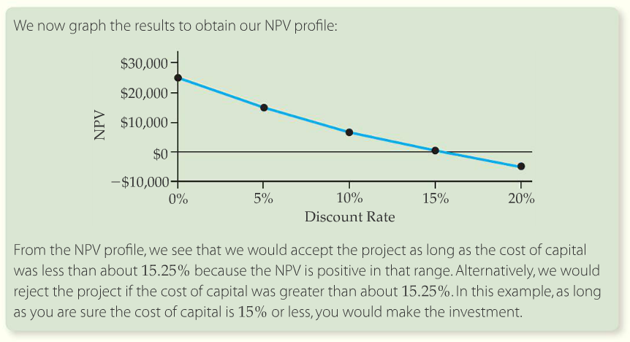
Net Present Value (NPV)
Professor James Kuhle, Ph.D.
Notes:
Graph from p. 9.3.17

Slide 22
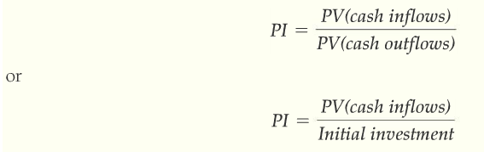
Profitability Index (PI)
Profitability index (cost-benefit ratio)
  Uses the same inputs as NPV
Professor James Kuhle, Ph.D.
Notes:
Equation 9.4 from p. 9.3.19

Slide 23
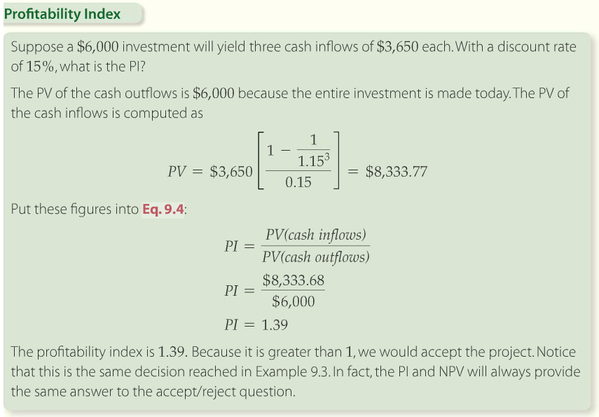
Profitability Index (PI)
Professor James Kuhle, Ph.D.
Notes:
Example 9.6 from p. 9.3.20

Slide 24
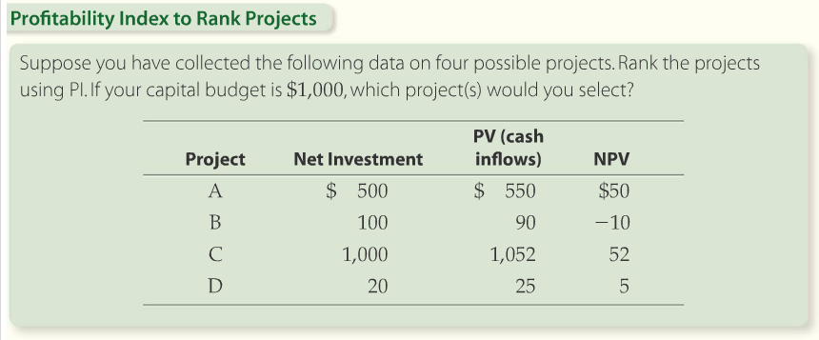
Profitability Index (PI)
Professor James Kuhle, Ph.D.
Notes:
Using PI to rank projects. Example 9.7 on page 9.3.21

Slide 25
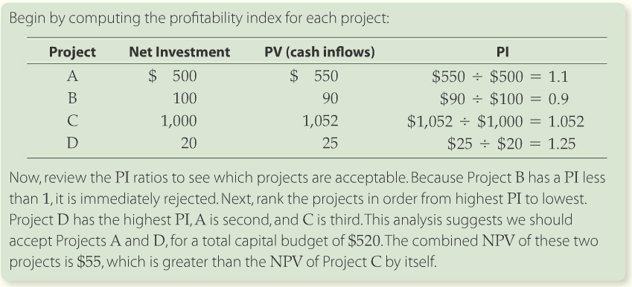
Profitability Index (PI)
Professor James Kuhle, Ph.D.
Notes:
Solution Tools on p. 9.3.22

Slide 26
PI Advantages/Disadvantages
Advantages
  PI is useful as an aid in ranking projects from best to worst
Disadvantages
  There are no theoretical problems with PI
  However, it should not replace NPV
Professor James Kuhle, Ph.D.

Slide 27
Internal Rate of Return (IRR)
Internal rate of return
  The discount rate that sets the present value of the cash inflows equal to the present value of the cash outflows
  The discount rate that sets NPV to zero
Theory
  Accept the project if the IRR is greater than or equal to the cost of capital
  Sometimes the cost of capital is called the hurdle rate
Professor James Kuhle, Ph.D.

Slide 28
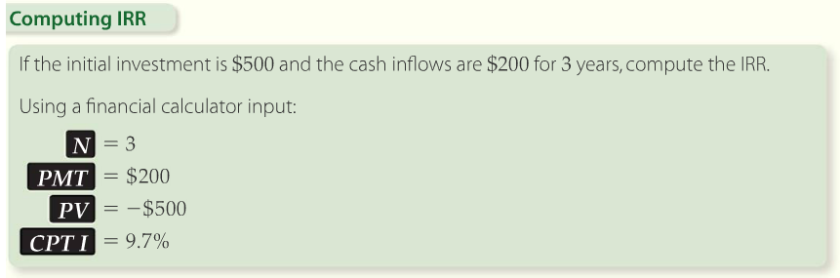
Internal Rate of Return (IRR)
Computation
Professor James Kuhle, Ph.D.
Notes:
Since IRR is mechanically a trial and error solution and involves lengthy interpolation, the easiest method is to use a financial calculator to solve for IRR. This is Example 9.8 on p. 9.3.27

Slide 29
IRR Advantages/Disadvantages
Advantages
  IRR is easy to interpret and explain
  Investors like to speak in terms of annual percentage returns when evaluating investment options
Disadvantages
  IRR assumes the cash flows are reinvested at the internal rate of return when they are received
  Cannot be used for ranking mutually exclusive projects
  IRR ignores differences in scale
  Will generate multiple IRRs if cash flows change direction
Professor James Kuhle, Ph.D.

Slide 30
NPV versus IRR
Choosing a method depends on…
  Your audience
  Whether you’re ranking projects
  Or simply determining acceptable projects
  And whether the project has alternating signs on the cash flows
Professor James Kuhle, Ph.D.
Notes:
Most firms use a variety of techniques and report all of them to management team.

Slide 31
Modified Internal Rate of Return (MIRR)
Find the present value of all cash outflows at the firm’s cost of capital
Find the future value of all cash inflows at the firms cost of capital
  All positive cash flows are compounded to the point at which the last cash inflow is received
Compute the rate that compounds the present value of the outflows so that they equal the future value of the inflows
Professor James Kuhle, Ph.D.
Notes:
The MIRR solves the reinvestment rate issue and the multiple IRR issue, but it is not widely known as a technique in practice.

Slide 32
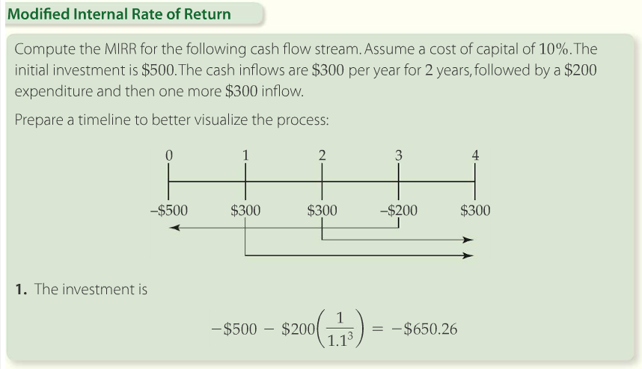
Modified Internal Rate of Return (MIRR)
Professor James Kuhle, Ph.D.
Notes:
Example 9.9 on p. 9.3.35. Also, see the Solution Tools on the same page.

Slide 33
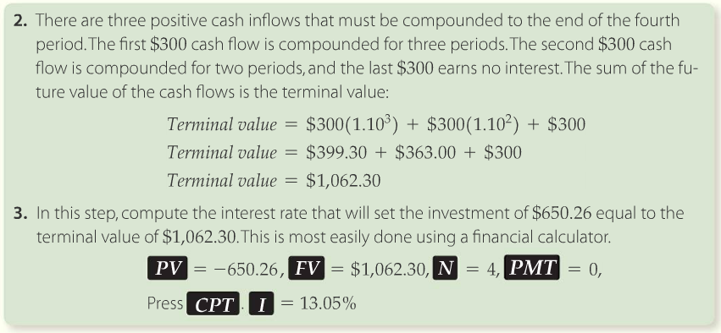
Modified Internal Rate of Return (MIRR)
Professor James Kuhle, Ph.D.
Notes:
Example 9.9 continued on p. 9.3.36

Slide 34
Capital Budgeting Introduction
END OF
CHAPTER 9
Professor James Kuhle, Ph.D.

Slide 35
Cost of capital
Chapter 11

Slide 36
Learning Objectives
LO1: Compute the cost of debt, preferred stock, and equity
LO2: Compute the weighted average of cost of capital
LO3: Select the correct WACC in multiple division companies

Slide 37
LO1: Computing the Cost of Debt, Preferred Stock, and Equity
Net present value (NPV)
  The sum or net of all discounted cash flows from a project
  Requires a discount rate to compute
Internal rate of return (IRR)
  The discount rate that sets the present value of the cash inflows equal to the present value of the cash outflows
Discount rate
  The rate of interest used to compute the NPV
Required rate of return
  A specified return required each period by investors for a given level of risk to be satisfied that they are sufficiently compensated
Notes:
Emphasize that we need to be able to come up with this discount rate, required return, etc.; until now it has been given to us.

Slide 38
Why Compute the Cost of Capital
This required return is known as the cost of capital
Cost of capital
  The cost, expressed as a percentage rate, that a firm must pay investors for the use of debt and equity financing
Weighted average cost of capital (WACC)
  The average cost of debt and equity financing where the average is computed as a weighted average using the long-term target weights of debt and equity in the balance sheet.
  Also referred to as the average cost of funds

Slide 39
Interpreting the Weighted Average Cost of Capital
If a firm does not earn the WACC, the firm’s value will fall
Therefore, WACC is used to evaluate investments
WACC must be adjusted and interpreted in light of how the funds will be used

Slide 40

Computing the Cost of Each Type of Security
After-tax cost of debt
  The cost of debt is the return that lenders demand on new borrowing
Notes:
Eq. 11.1 on p.11.1.7.
T is the marginal tax rate

Slide 41
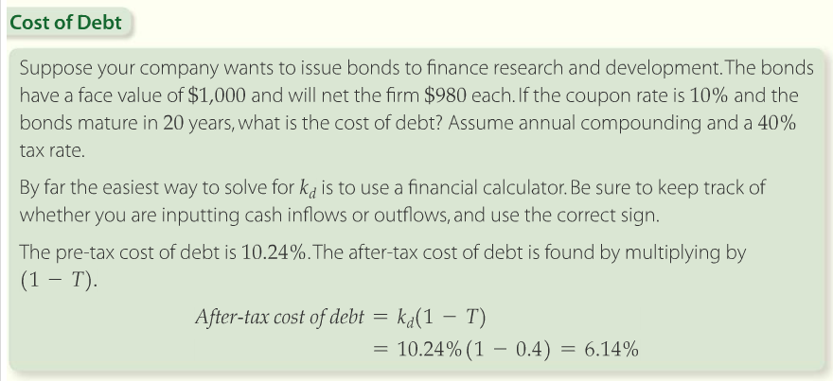
Computing the Cost of Each Type of Security
Notes:
Solution Tools on p.11.1.7

Slide 42
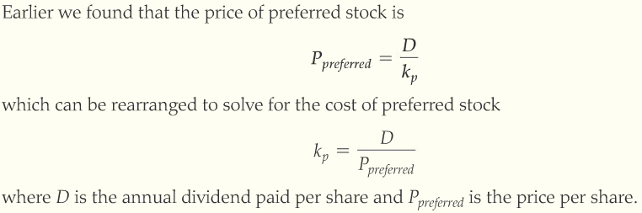
Cost of Preferred Stock
Dividends are not tax deductible
  This makes the after-tax cost of preferred stock debt higher than the after-tax cost of similarly risky debt
Notes:
Eq. 11.2 on p.11.1.10

Slide 43
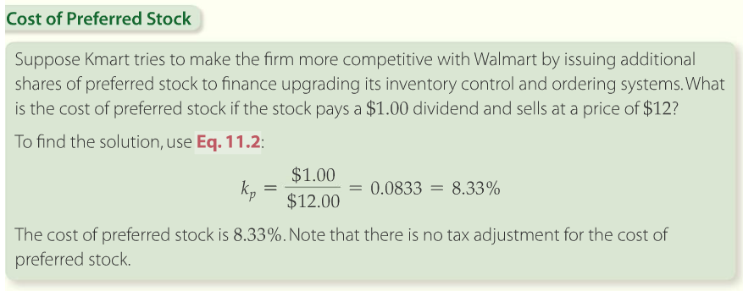
Cost of Preferred Stock
Notes:
Solution Tools on p.11.1.11

Slide 44
Cost of Common Stock
Can be calculated three ways
1) Using CAPM
2) Using Constant Growth Model
3) Using Bond Yield plus a Premium
Notes:
We will explore all three methods of calculation.

Slide 45
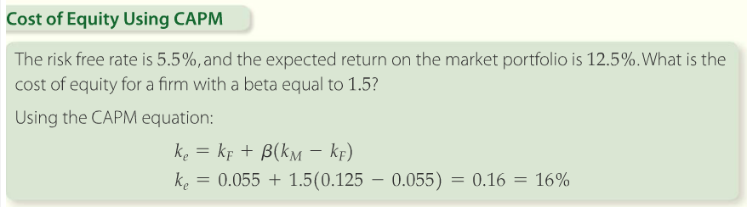
Cost of Common Stock
Capital asset pricing model (CAPM)
  Describe the relationship between the required return, or cost of common stock equity capital, and the non-diversifiable risk of the firm as measured by the beta coefficient
Notes:
Solution tools on p.11.1.14

Slide 46

Cost of Common Stock
Constant growth model
  A model for computing the value of stock that assumes dividends grow at a constant rate forever and that the price is the present value of these dividends
Constant growth valuation model
Notes:
Eq. 11.4 on p. 11.1.15

Slide 47
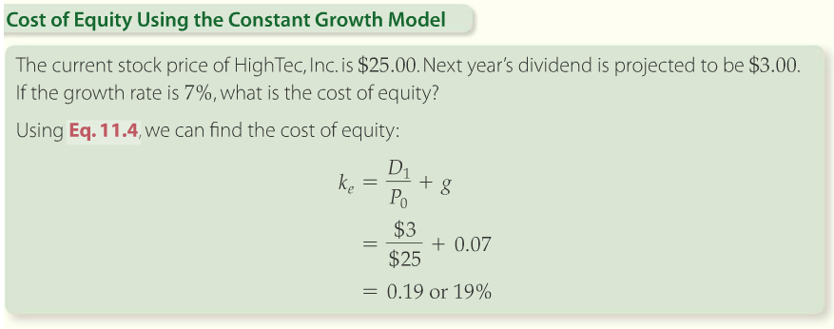
Cost of Common Stock

Slide 48

Cost of Common Stock
Bond yield plus premium
  Another method used to compute the cost of equity involves adjusting cost of debt by adding a risk premium
  Risk premium is an additional return investors require due to the increased risk one investment has over another
Notes:
Equation 11.5 on page 11.1.17

Slide 49
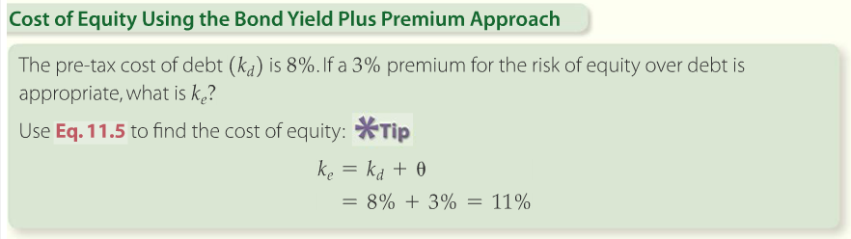
Cost of Common Stock
Notes:
Solution Tools on p. 11.1.17

Slide 50
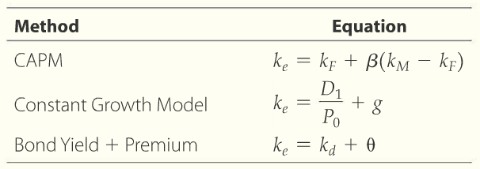
Cost of Common Stock
Reconciling the models
Notes:
From p. 11.1.18.

Slide 51
Three methods
Which method is best?
If all 3 give you similar answers, it will give you confidence in your estimate
In many cases, the answers will differ
Some firms use an average of the three results
Others may trust one metric over the others

Slide 52
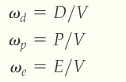
LO2:Computing a WACC
The value of all of the company’s securities is V
  V = E + D + P
SO,
Capital structure weights in the WACC formula
Notes:
Equation 11.6 on p. 11.2.1.

Slide 53

Computing Capital Structure Weights
The sum of the weights must equal 1
Weighted average
  Found by multiplying each cost component by its weight
  An average that is based on the proportion of each element in the total

Slide 54
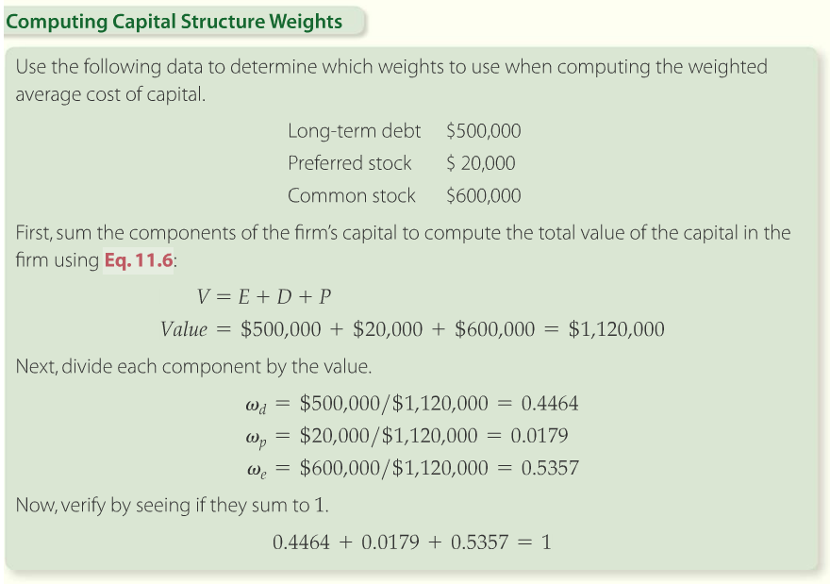
Computing Capital Structure Weights
Notes:
Solution Tools on p. 11.2.3

Slide 55
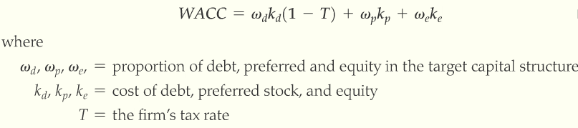
Putting it All Together
To find the WACC
  Multiply each components cost by the proportion it occupies in the target mix
Notes:
Eq. 11.7 on p. 11.2.4.

Slide 56
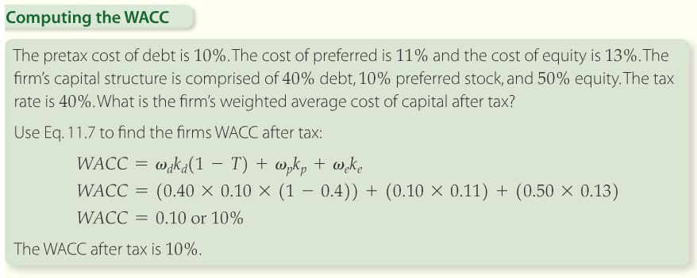
Putting it All Together
Notes:
Solution Tools on p. 11.2.4

Slide 57
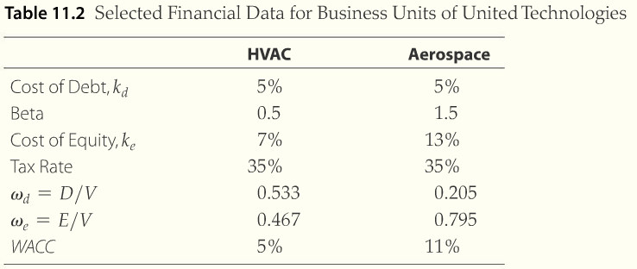
LO3: Divisional Cost of Capital
Divisional cost of capital
  The cost of capital computed for a specific unit or division within a company that reflects that areas weighted average cost of funds
Notes:
Some divisions may have widely differing levels of risk and you should use divisional WACCs that reflect this risk.

Slide 58
End of Chapter 11
Cost of Capital

Slide 59
Capital structure
Chapter 12

Slide 60

Learning Objectives
LO1: Learn how to measure leverage
LO2: Explore the impact of leverage on EPS on ROE
LO3: Determine the optimal capital structure

Slide 61
Capital Structure
The mix of a long-term debt and equity used by the firm to finance its assets
Corporate borrowing increases risks to shareholders and leads to stockholders requiring higher returns
Factors that change required returns affect value since V = present value of cash flows

Slide 62
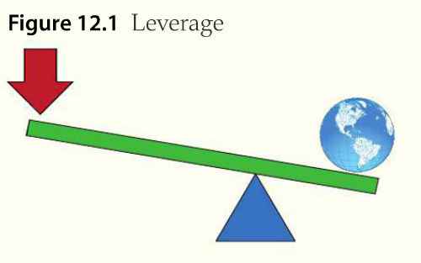
LO1: Measures of Leverage
Notes:
Leverage helps magnify any type of result, financial or otherwise. Figure 12.1 from p. 12.1.1

Slide 63
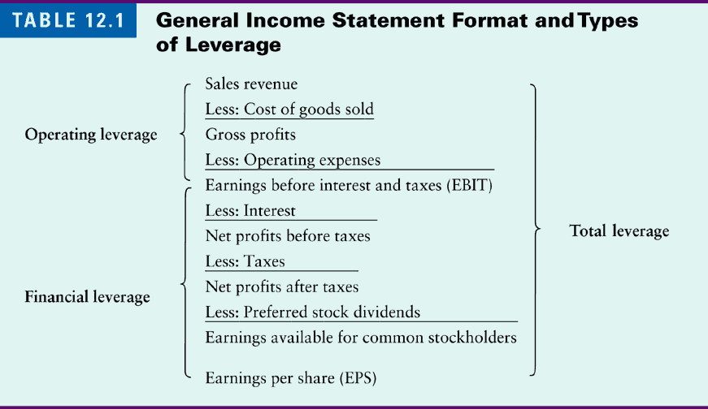
Leverage
Table Number 1

Slide 64
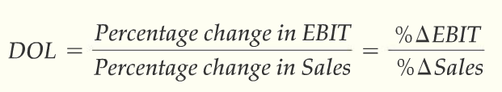
Operating Leverage
Operating leverage
  Fixed costs create operating leverage
  Measured by the degree of operating leverage (DOL)
Degree of operating leverage (DOL)
  The percentage change in EBIT divided by the percentage change in sales
Earnings before interest and taxes (EBIT)
Notes:
Eq. 12.1 on p. 12.1.2
DOL tells us how much earnings will change for a given change in sales.

Slide 65
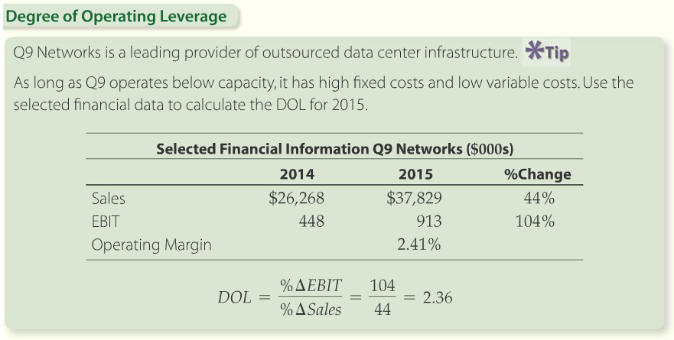
Operating Leverage
Notes:
Example 12.1 from p. 12.1.3

Slide 66
Financial Leverage
Financial leverage
  Financial leverage increases the expected return on equity, but also accentuates the variability of net income relative to the variability of operating profit.
  Measured by Degree of Financial Leverage (DFL)
Earnings per share (EPS)
  Earnings is the same thing as net income

Slide 67
Leverage
Table Number 1

Slide 68

Financial Leverage
Degree of Financial Leverage (DFL)
  The percentage of change in EPS divided by the percentage change in EBIT
Notes:
Eq. 12.2 on p. 12.1.4

Slide 69
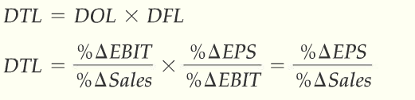
Total Leverage
Total leverage
  A measure of leverage that combines operating and financial leverage
Degree of total leverage (DTL)
  The percentage change in EPS divided by the percentage change in sales
Notes:
Eq. 12.3 on p. 12.1.5.
Emphasize that total leverage is multiplicative.

Slide 70
Leverage
Table Number 1

Slide 71
LO2: Effect of Leverage
Return on equity (ROE)
  Tells what the firm earns on every dollar of equity
  Return is based on the book value of equity, not current market value
  Many analysts consider ROE the most important of all ratios

Slide 72
LO3: Optimal Capital Structure
Optimal capital structure
  The capital structure that produces the highest firm value of all capital structures
Financial distress
  The events leading up to and including bankruptcy, such as a violation of loan covenants
Principal-agent problems
  The problems and costs that occur when an agent does not maximize the utility of the principal
Static tradeoff theory
  The theory that optimal capital structure is determined by a trade-off of the value of tax shields against financial distress costs and the agency costs and benefits
Notes:
These are the primary topics we will cover under this LO.

Slide 73
Optimal Capital Structure with Perfect Markets
M&M Proposition 1: Debt and Value
  States that capital structure is irrelevant
  Investors can buy shares in an all equity company and create their own leverage or buy shares in a levered company and undo the leverage
No arbitrage
  The no-arbitrage condition is the same as the law of one price. If two identical assets trade in two different markets then they must trade for the same price.
  If not, then there are arbitrage trading opportunities
  Additional proof of M&M Prop 1

Slide 74
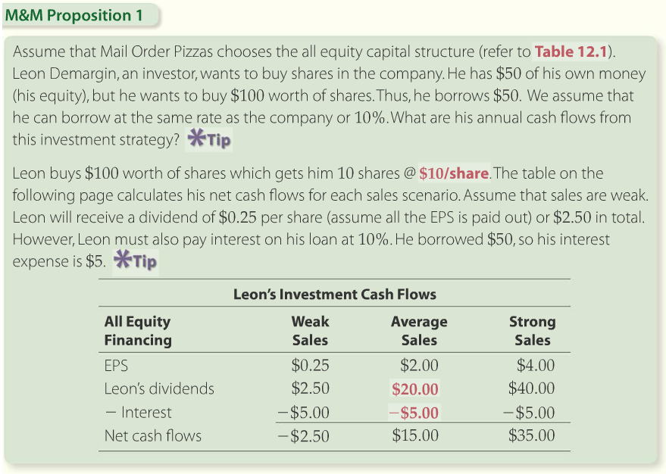
Optimal Capital Structure with Perfect Markets
Notes:
Solution Tools on p. 12.3.4

Slide 75
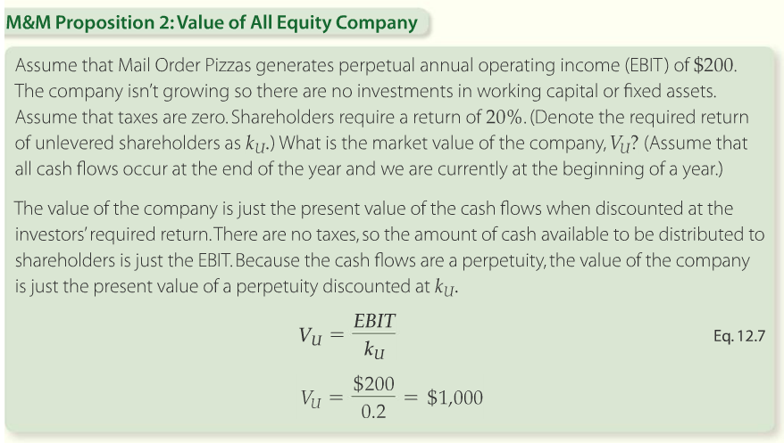
Optimal Capital Structure with Perfect Markets
M&M Proposition 2: Debt and Required Return
Notes:
M&M Prop. 2 states that WACC is unaffected by debt. As firms increase use of lower cost debt, the required return from equity increases to exactly offset the lower cost debt. Therefore WACC stays the same. From p. 12.3.7

Slide 76



Optimal Capital Structure with Perfect Markets
The value of the levered firm
WACC is constant for all levels of debt
M&M proposition 2
Notes:
Equations 12.8, 12.9 and 12.10 on p. 12.3.8

Slide 77
Optimal Capital Structure with Taxes
Interest tax shield
  Equal to the product of the interest expense and the corporate tax rate. It is the amount by which taxes are reduced due to interest tax deductibility
Operating cash flow
  Revenues less costs and taxes. Also equal to the net income plus interest and depreciation
Notes:
The tax deductibility of interest shifts the preferred capital structure toward debt.

Slide 78


Optimal Capital Structure with Taxes
M&M Proposition 1: Debt and Value (with Taxes)
  Larger than with all equity financing
  The difference is equal to the interest tax shield
Value of the levered company
Present value of the interest tax shield perpetuity
Notes:
Eq 12.11 & Eq. 12.12 on pp. 2.3.13 and 12.3.14

Slide 79
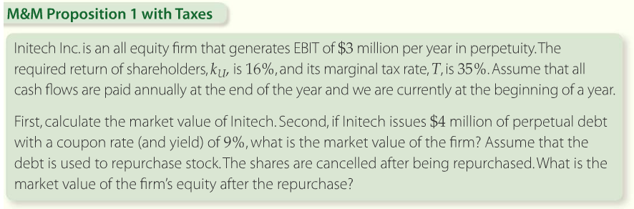
Optimal Capital Structure with Taxes
Notes:
Example from p 12.3.14

Slide 80
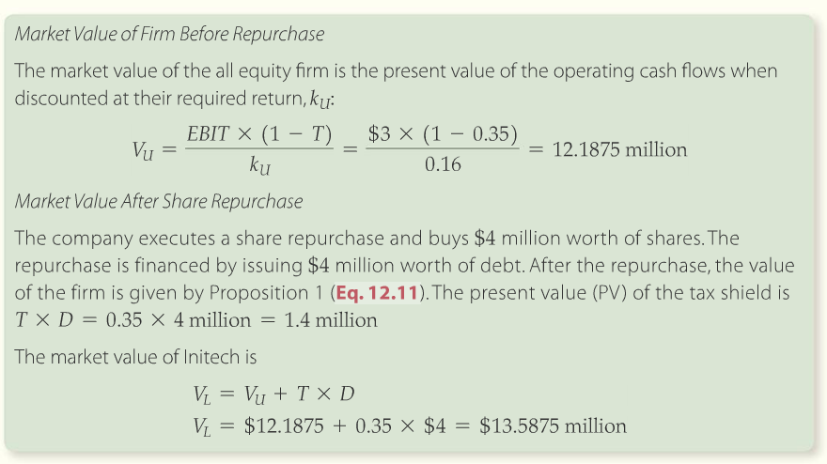
Optimal Capital Structure with Taxes
Notes:
Solution Tools Video on p. 12.3.15

Slide 81
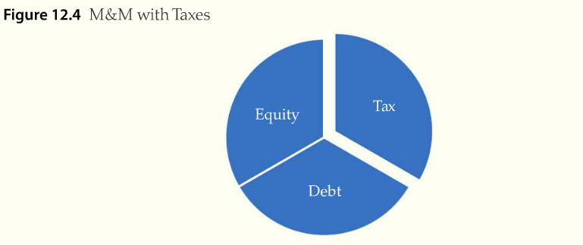
Optimal Capital Structure with Taxes
Notes:
M&M’s main insight is that debt can reduce the “tax” slice of the pie and result in higher returns to shareholders. From p. 12.3.16

Slide 82

Optimal Capital Structure with Taxes
M&M Proposition 2: Debt and Required Return (with taxes)
  The cost of equity in an increasing function of leverage
Notes:
WACC now declines as leverage goes up because the increase in the required return to equity is not a direct offset to benefits of lower cost debt. Eq. 12.13 from p. 12.3.17

Slide 83
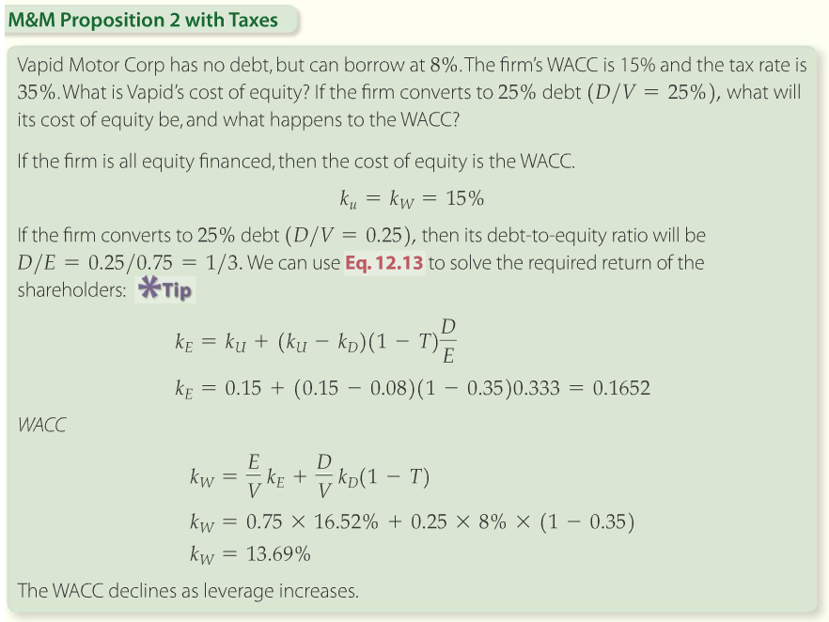
Optimal Capital Structure with Taxes
Notes:
Solution Tools on p. 12.3.18

Slide 84
The Static Tradeoff Theory
Financial distress costs
  When a company cannot make interest or principal payments it declares bankruptcy
Federal bankruptcy laws
  Chapter 11 will aid to reorganize a business to become profitable again
  Or, some bankrupt firms cease operations and secured creditors are paid first, once assets are liquidated
  Unsecured creditors have the next claim
Under the static tradeoff theory, the value of levered firm
Notes:
Static tradeoff adds the cost of financial distress to the valuation model. Eq. 12.14 from page 12.3.24

Slide 85
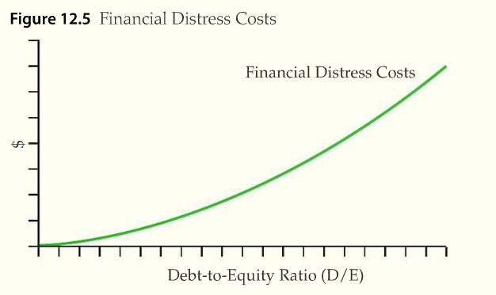
The Static Tradeoff Theory
    Financial distress costs are the direct and indirect costs of bankruptcy
Notes:
Costs of financial distress increase as debt increases. From p. 12.3.23

Slide 86
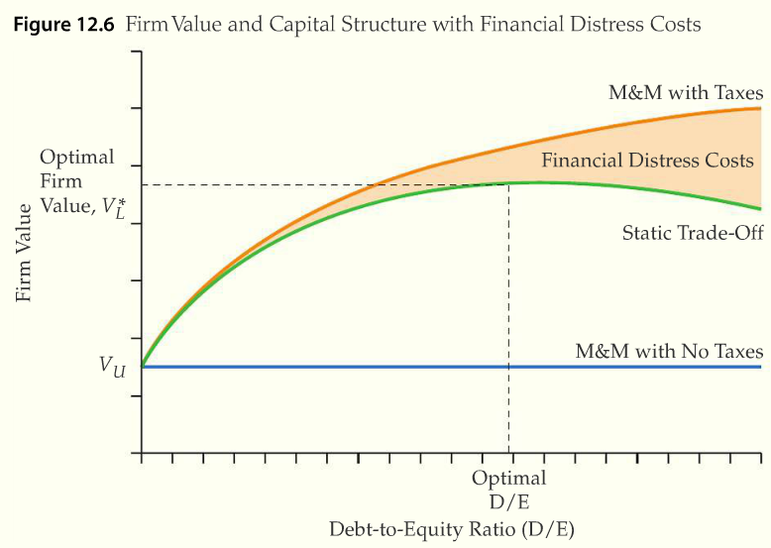
The Static Tradeoff Theory
Notes:
Figure 12.6 from p. 12.3.25. The value of the firm is affected by tax benefits and financial distress costs.

Slide 87

The Static Tradeoff Theory
Agency Costs
  Stockholders have no operational control over companies
  Stockholders vote for members of the board
  Members of the board hire the CEO
  The CEO hires senior managers
  The senior executive team makes operational decisions.
Agency costs and static tradeoff theory
Notes:
Managers and stockholders can have differing goals; this results in agency costs. Eq. 12.15 from p. 12.3.28

Slide 88
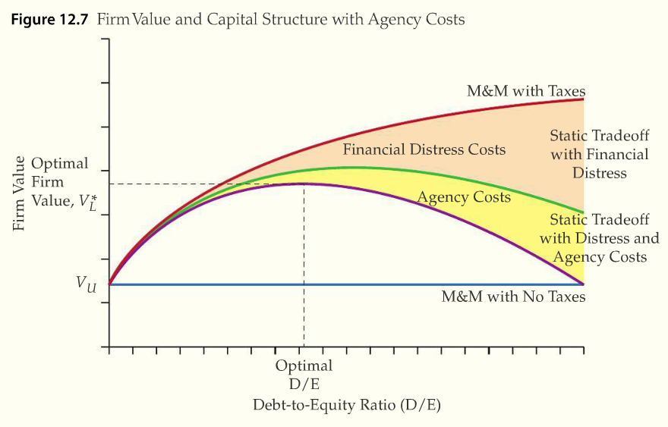
The Static Tradeoff Theory
Notes:
Now the firm value must be adjusted to reflect increasing agency costs to monitor management. Figure 12.7 from p. 12.3.29

Slide 89
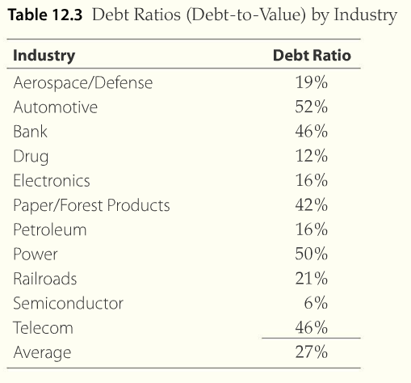
Conclusions
Notes:
Debt ratios are industry dependent. Some industries have greater stability of cash flows and can service more debt.

Slide 90
Conclusions
Tax Considerations
  M&M propositions 1 and 2 implies that firms should use some debt in their capital structure
Rising debt means rising costs of financial distress
  As debt increases, so do financial distress costs
  Optimal debt level balances this cost against the tax benefit of using debt

Slide 91
Conclusions
Debt affects principal-agent conflicts
  As debt increases, managers have less free cash flow to waste, but shareholders are increasingly likely to accept long-shot projects
Differences in risk among firms
  Firms with variable sales and/or high operating leverage have a higher probability of financial distress and are likely to maintain low debt ratios to maintain acceptable total risk

Slide 92
Conclusions: Other Considerations
Some firms value flexibility provided by low debt more than other firms do
Some owners and managers are more concerned about risk than others
Some owners want to retain control of their companies and so prefer debt over equity
Not all companies need the interest tax shield and so use less debt

